Slide 1

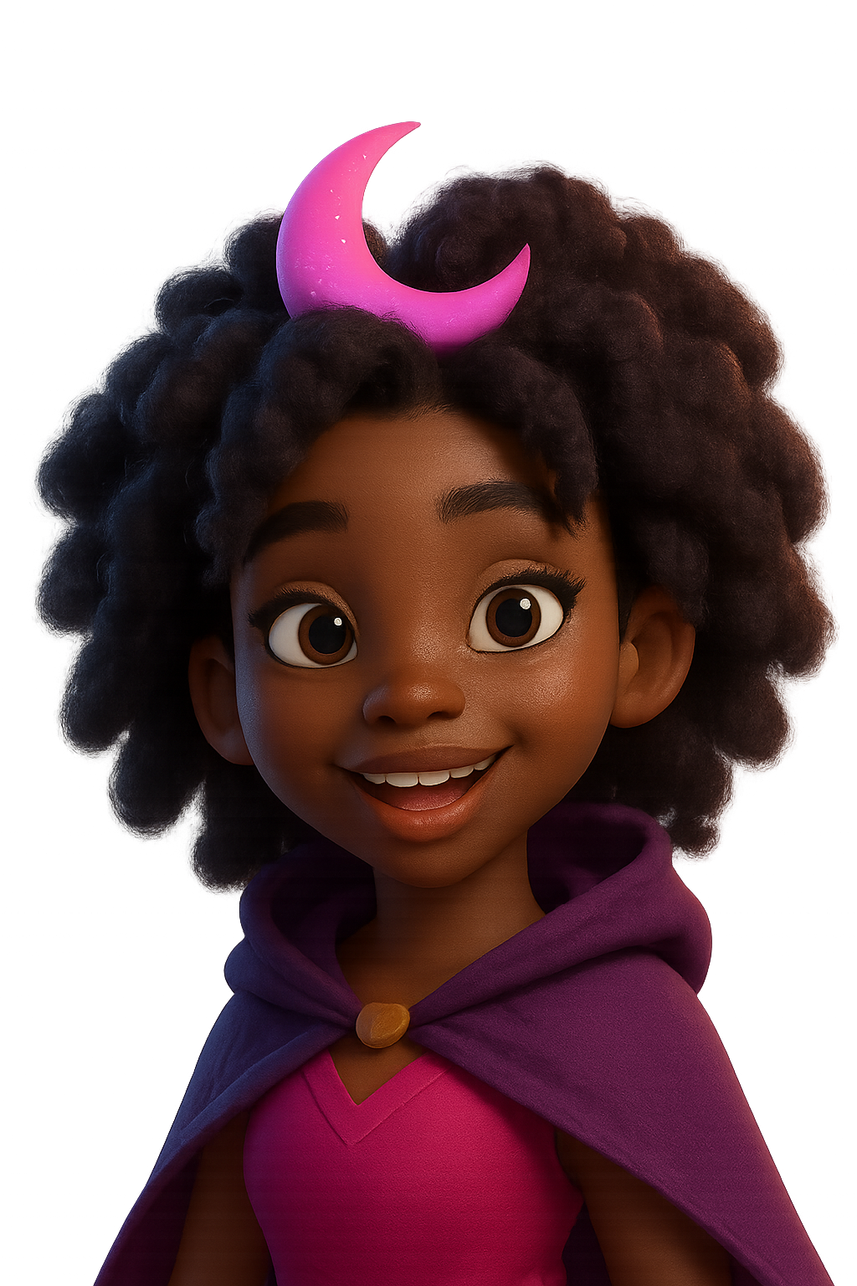
A Fantasy Webtoon Reader

Slide 2

Problem / Opportunity
Millions of Nigerian women love fantasy webtoons but face barriers: payment, access, and community.
90% struggle with FX fees and payment failures.
Lack of culturally relevant digital fan products.

Slide 3

Solution
Webtoon Payment Playbook: Step-by-step Naira payment guide.
Curated 2025 Fantasy Webtoon List with ‘If you liked X, try Y’.
Digital Flex Pack: Afro-fantasy stickers, templates, and badges.
Exclusive Telegram community with live updates.

Slide 4
How It Works
Purchase Dreamara kit (₦2,500 – ₦4,500).
1
Instant download of guides and digital assets.
2
Join private community channel for updates and challenges.
3

Slide 5
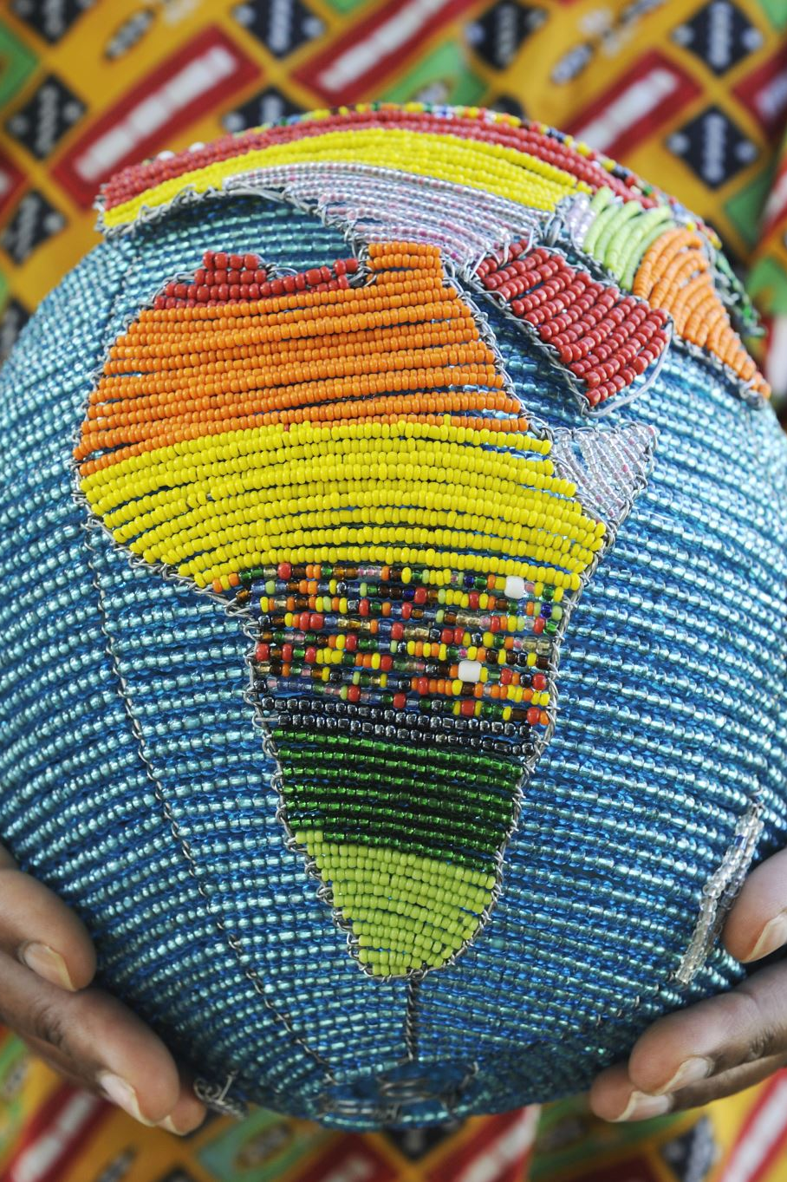
Market Size & Target Audience
TAM: 20M+ Nigerian fantasy readers.
SAM: 5M active on fan communities.
SOM: 300K early adopters (6% conversion).

Slide 6
Business Model
One-time kit sales (₦2,500 – ₦4,500).
Subscription: Dreamara Queen Club (₦1,000/month).
Affiliate commissions on virtual card sales.
Sponsored content and creator partnerships.

Slide 7
Traction & Validation
Waitlist of 5,000+ signups in pre-launch.
Partnerships with 10 micro-influencers.
Positive social listening feedback on payment hacks.

Slide 8

Competitive Landscape
Webtoon App: Content distribution, no local payment guide.
Tappytoon/Manta: Pricey, no cultural localization.
WhatsApp Groups: Informal, lack downloadable assets.

Slide 9
Go-to-Market Strategy
Micro-influencers on TikTok & Instagram.
Campus ambassador program at universities.
Referral contest and early-bird bonuses.

Slide 10

Financial Projections
Year 1: ₦3.0M revenue, ₦2.0M profit.
Year 2: ₦10.2M revenue.
Year 3: ₦23.5M revenue.

Slide 11
Team
Founder: Digital marketer with Nigerian market expertise.
Advisors: Webtoon creators and payment integration experts.
Freelance design and community management support.

Slide 12
Ask & Use of Funds
Raising ₦5M seed (~$3,500).
40% marketing,
30% content & design
20% tech
10% operations.

Slide 13
Vision & Impact
Expand to multiple genres and regions.
1
Empower African female fans and creators.
2
Build creator-supported ecosystem.
3

Slide 14
Thank You
Contact: your.name@example.com
Phone:
WhatsApp / Social links

